Slide 1
CSCI 331 – Group Project 2
Members: Timothy Dakis (Group Leader), Mikhaiel Gomes, Shivanie Kemraj (Backup Group Leader), Konrad Rakowski, Kevin Tang

Slide 2
Project Management
This section of the presentation will show aspects of project management, it will include:
The project plan
Briefly speak of how the group assisted each other
Screenshots of all to-do lists by member
Screenshot of Gannt chart

Slide 3
The Project Plan
Restore the backup, add the columns to each table and the new tables one would need to work on their procedures
Work on assigned procedures
Also set up sequences as default values in place of the identities
Group leader debugs all procedures and then puts everything into a final version of the database, and creates a backup to send out for others to restore
Group leader makes slides, group members send necessary screenshots
Record

Slide 4
Use of Discord, and how the Group Assisted Each other
No formal meetings held during the project

Slide 5
In Lieu of Regularly Scheduled Meetings…
We utilized Discord to organize and manage parts of the project and deadlines

Slide 6
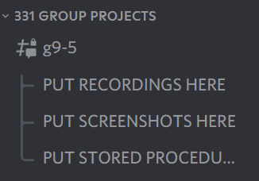
Example: to ensure everyone’s work is submitted, threads were used to compile results

Slide 7
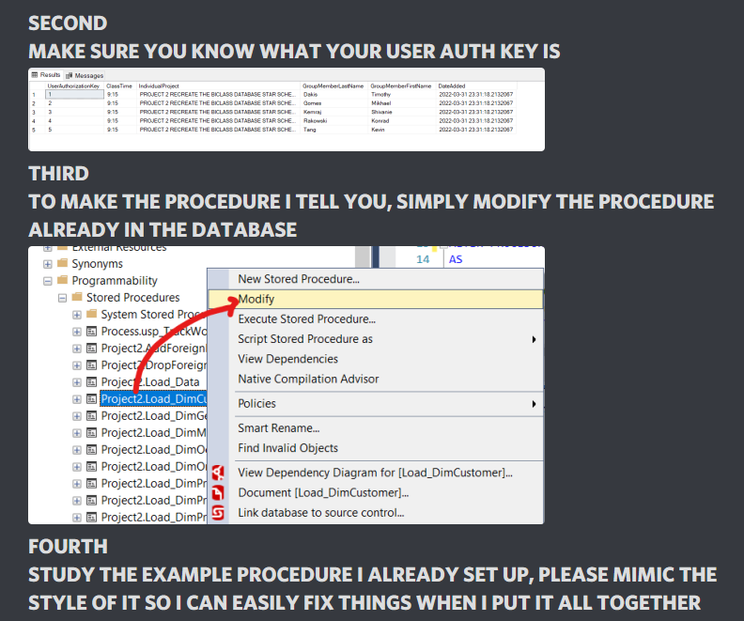
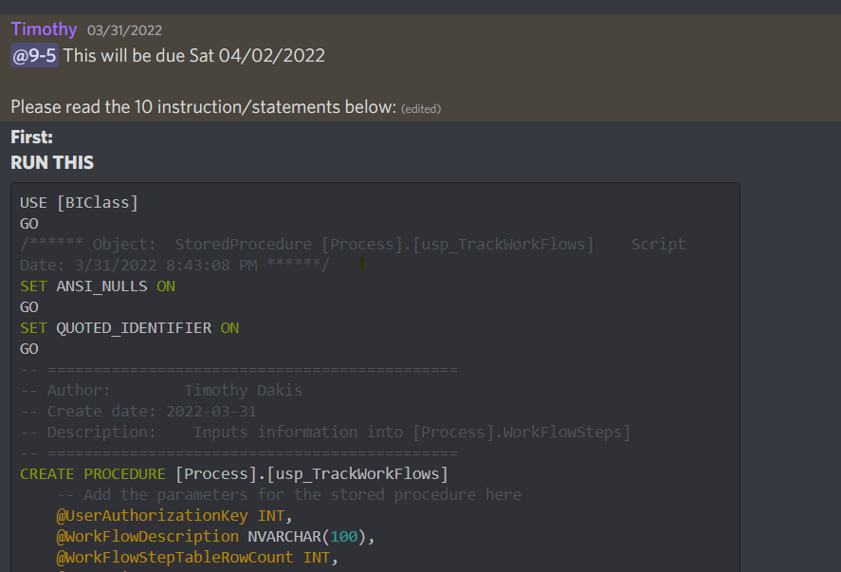
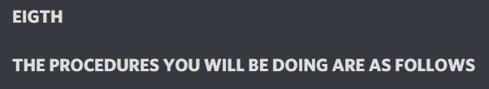
Example: Utilizing Discord to announce deadlines for people, as well as provide information

Slide 8
Group Assistance
Explained how to add columns to tables for those confused
Provided SQL code necessary to create necessary tables when needed
Pointed out issues in procedures before final versions submitted to group leader to compile everything
Pointed out if anything was missing from the project specs, and if anything was missing from the PowerPoint

Slide 9
To-Do List and Gannt Chart

Slide 10
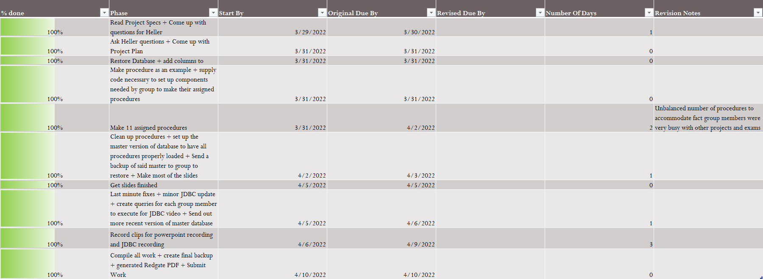
To-Do List For Timothy Dakis

Slide 11
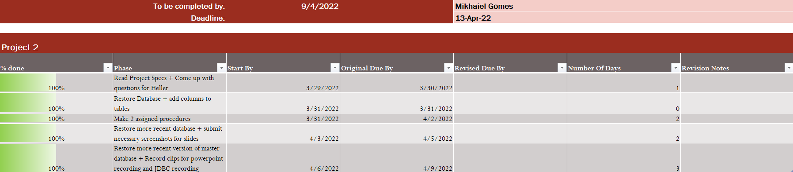
To-Do List For Mikhaiel Gomes

Slide 12
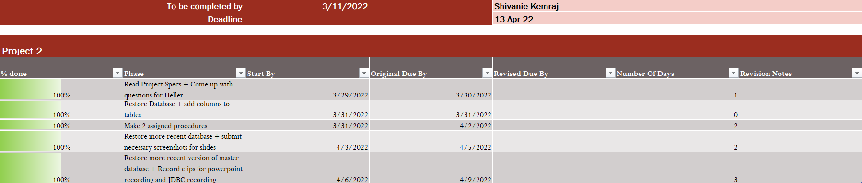
To-Do List For Shivanie Kemraj

Slide 13
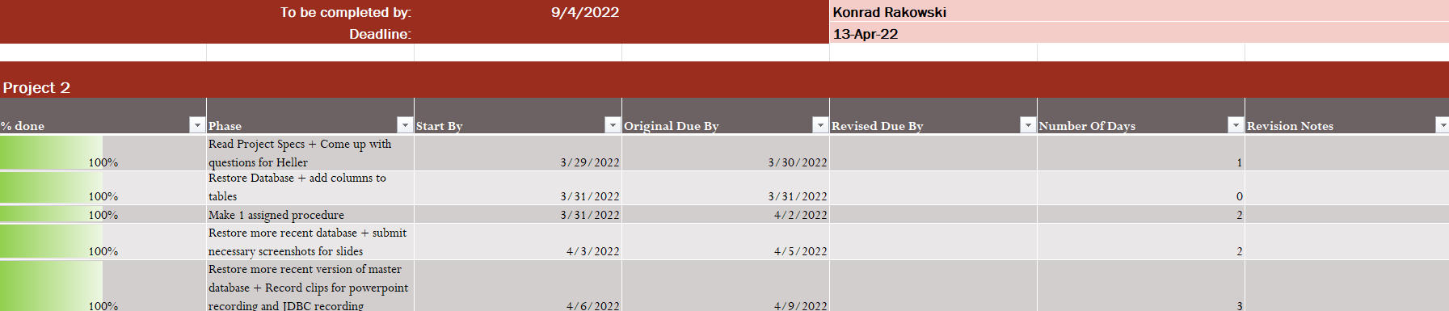
To-Do List For Konrad Rakowski

Slide 14
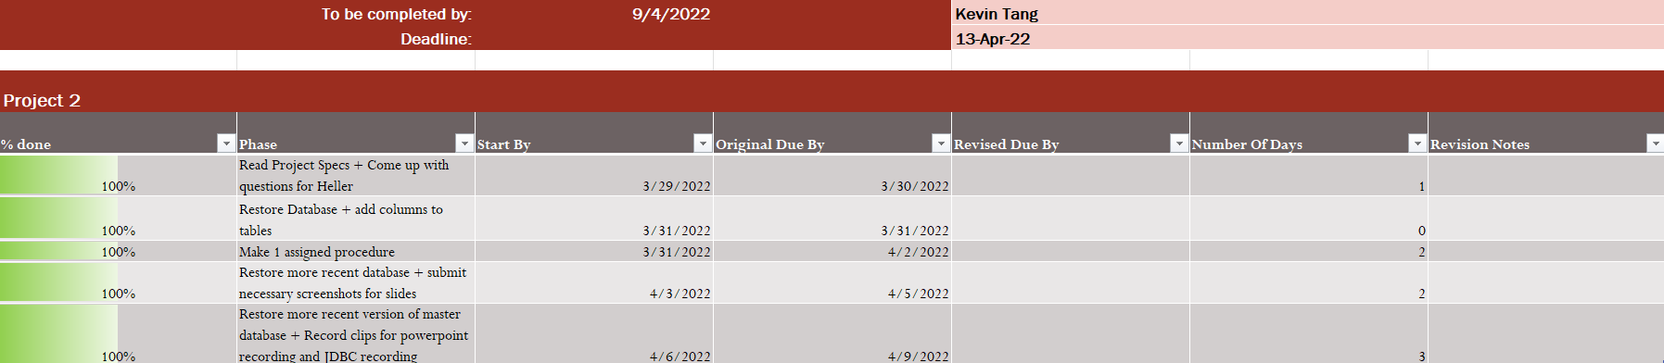
To-Do List For Kevin Tang

Slide 15
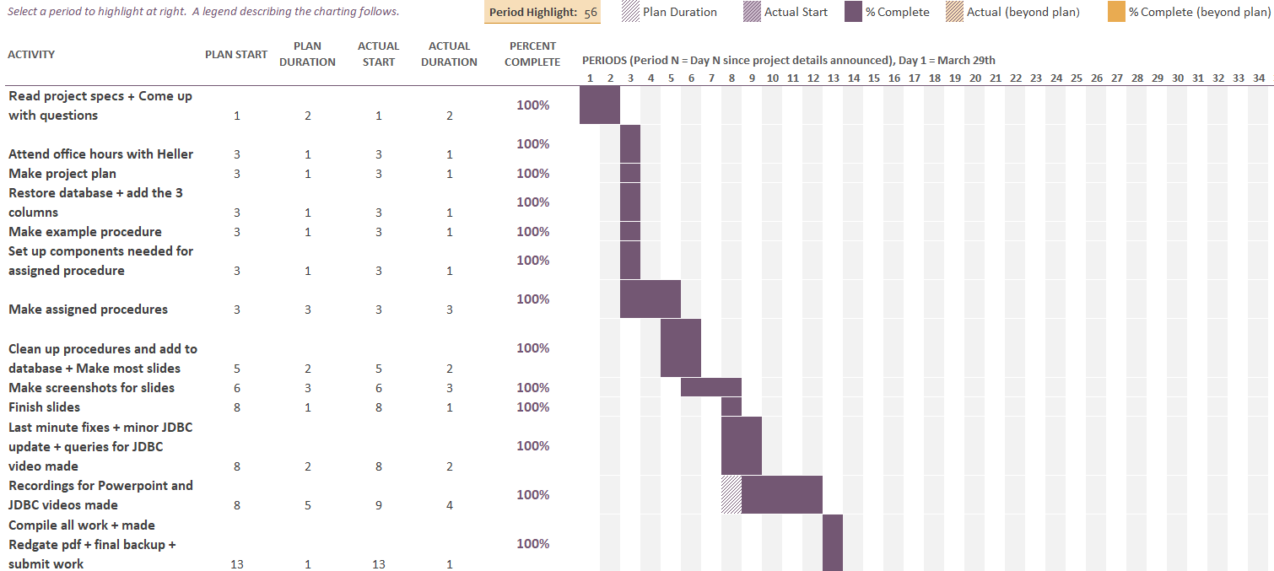
Gannt Chart

Slide 16
Stored Procedures

Slide 17
Stored Procedures
This section of the presentation will go over the created stored procedures, it will include:
A screenshot of each procedure
The execution time of each procedure, as well as its log entry in the WorkFlowSteps table
Where applicable, a JDBC output of the view created by the procedure
At the end, an analysis summary containing:
Total time to load the star schema, as well as the query used to confirm and verify this
The procedures worked on per person
Total execution time of each member’s stored procedures, along with their portion of logged work from the WorkFlowSteps table, as well as the query used to compute this

Slide 18
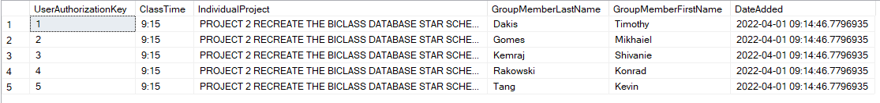
General Note Related to Procedures
All the procedures takes a UserAuthorizationKey input, the input of this would be based on the user’s key within the DbSecurity.UserAuthorization table below:

Slide 19
Timothy Dakis’s Procedures

Slide 20
Procedures Done by Timothy Dakis
Process.usp_ShowWorkflowSteps
Process.usp_TrackWorkFlow
Project2.AddForeignKeysToStarSchemaData
Project2.DropForeignKeysFromStarSchemaData
Project2.Load_Data
Project2.Load_DimCustomer
Project2.Load_DimProduct
Project2.Load_DimProductCategory
Project2.Load_DimProductSubcategory
Project2.LoadStarSchemaData
Project2.ShowTableStatusRowCount
Project2.TruncateStarSchemaData
Utils.DropProcsInCSCI331FinalProject

Slide 21
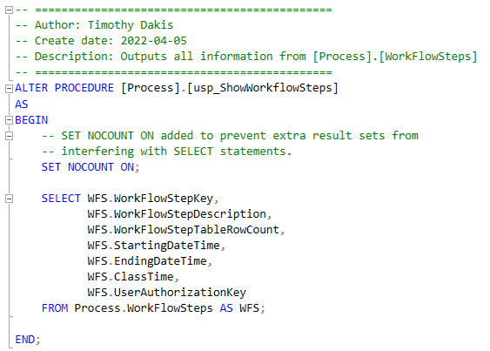
Process.usp_ShowWorkflowSteps

Slide 22
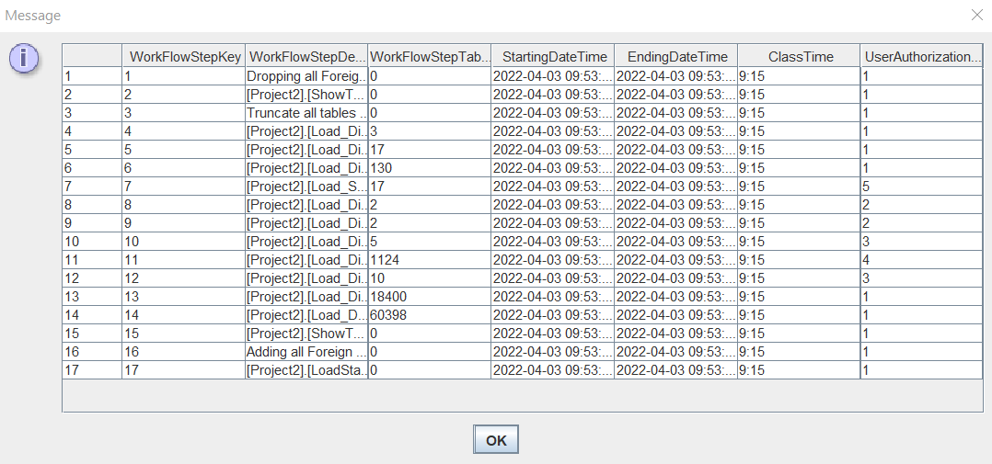
JDBC Output of Procedure: (Projects Process.WorkFlowSteps Table)

Slide 23
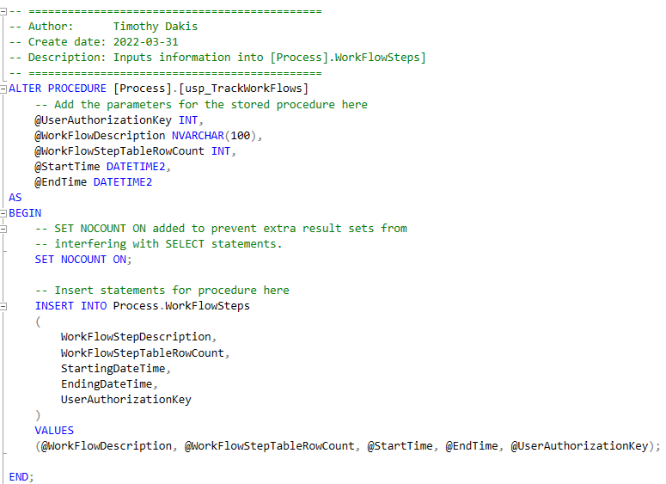
Process.usp_TrackWorkFlow

Slide 24
JDBC Output of Table Filled Table: Process.WorkFlowSteps

Slide 25
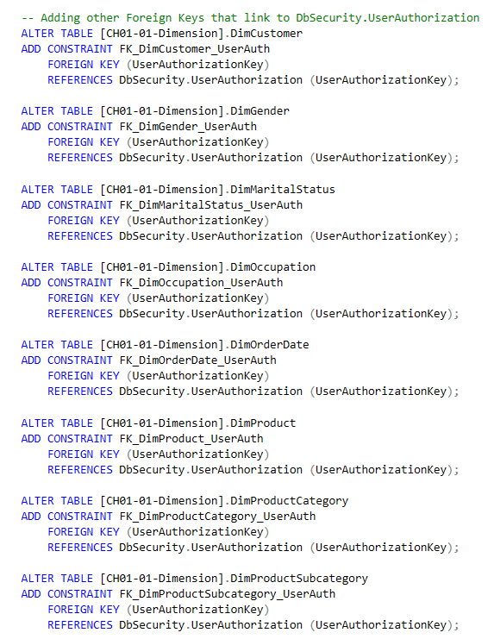
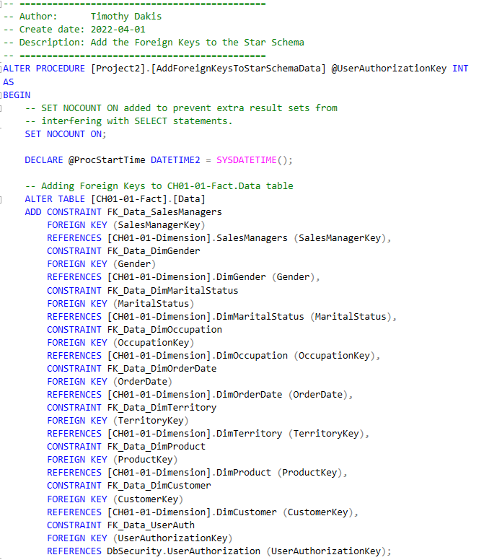
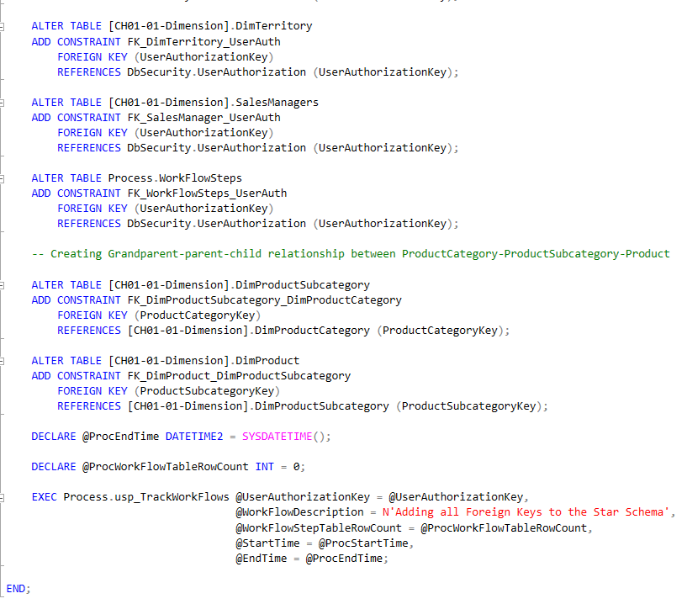
Project2.AddForeignKeysToStarSchemaData

Slide 26
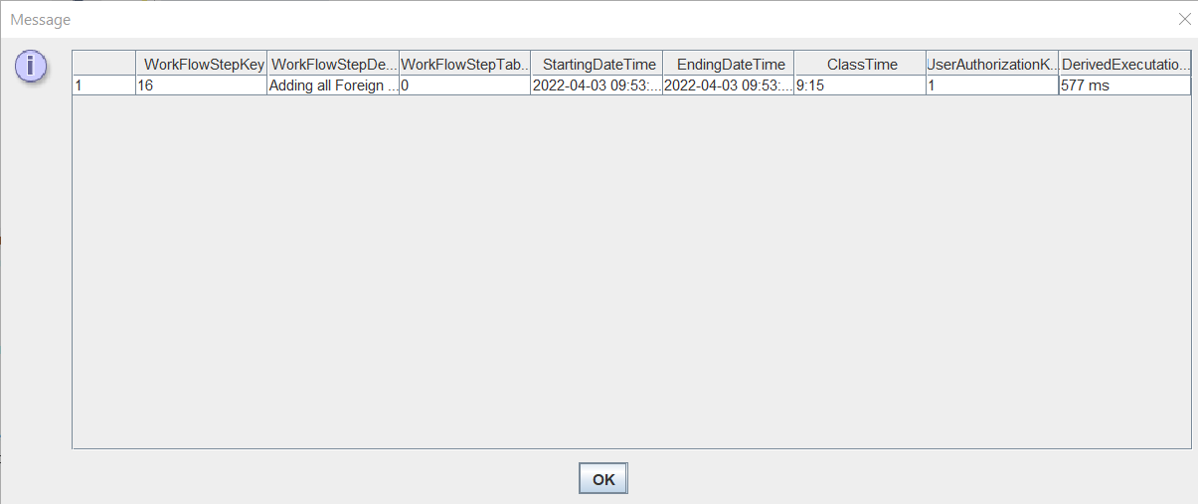
WorkFlowSteps log Entry and Execution time
Execution time: 577ms (0.577s)

Slide 27
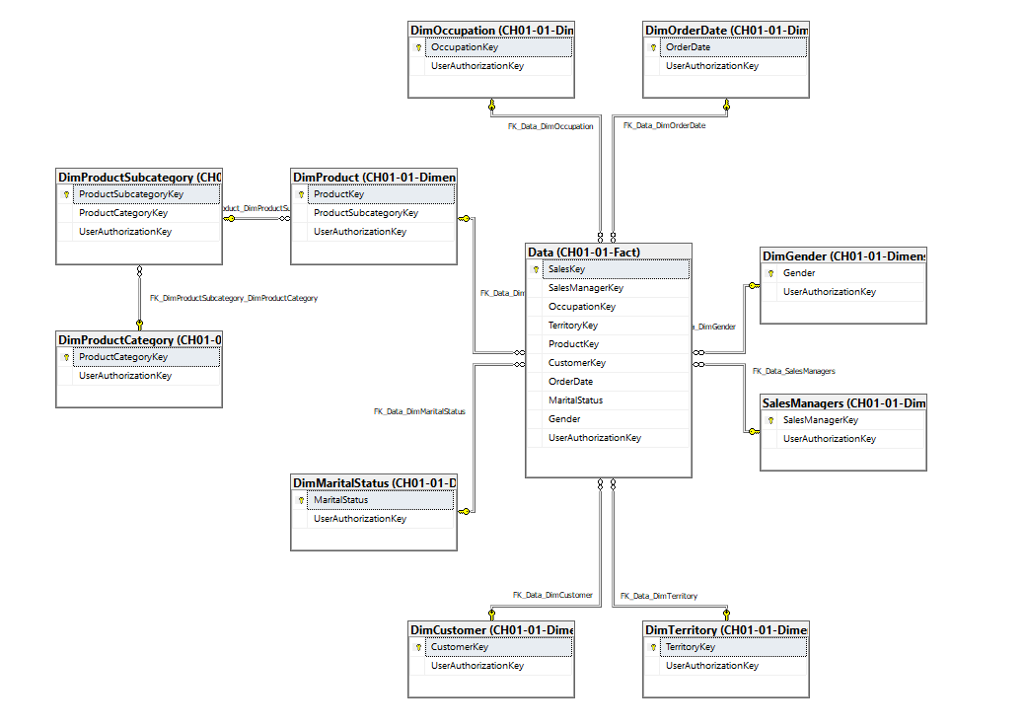
Diagram Showing Relationships (Excluding DbSecurity.UserAuthorization)

Slide 28
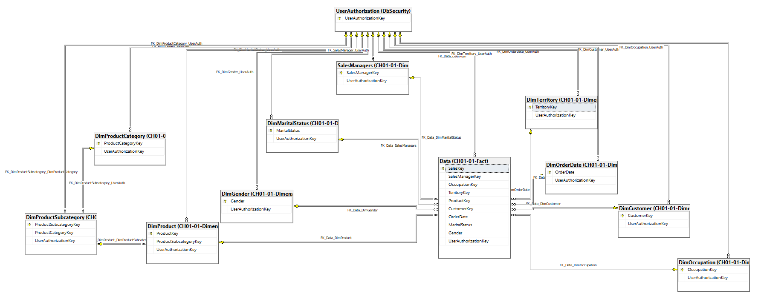
Diagram Showing Relationships (Including DbSecurity.UserAuthorization)

Slide 29
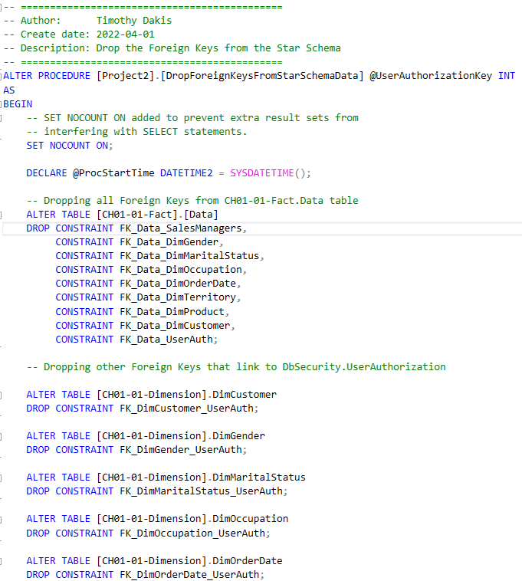
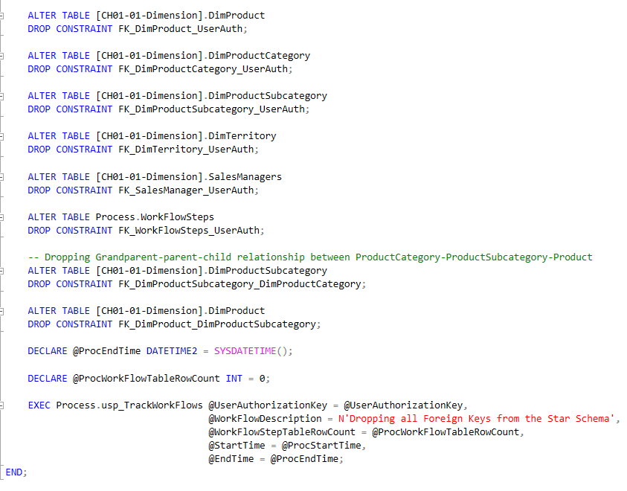
Project2.DropForeignKeysFromStarSchemaData

Slide 30
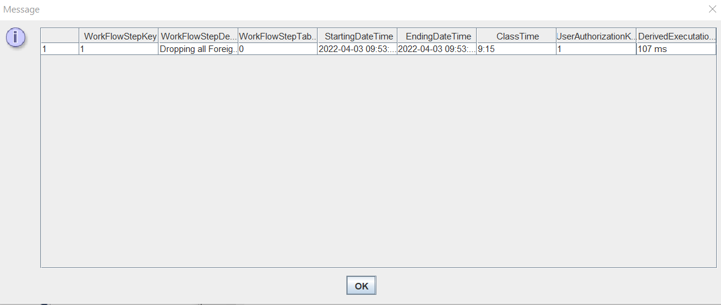
WorkFlowSteps log Entry and Execution time
Execution time: 107ms (0.107s)

Slide 31
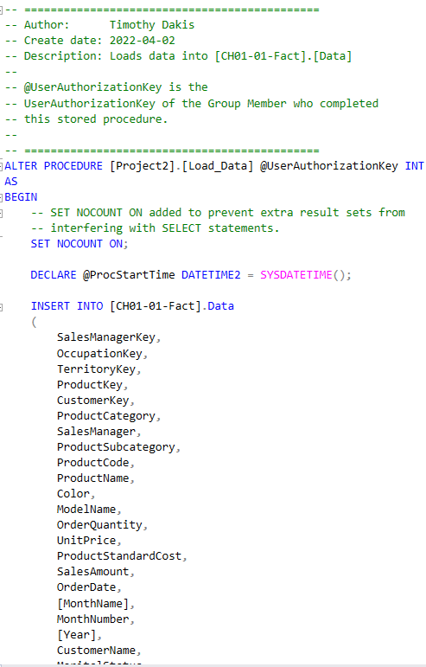
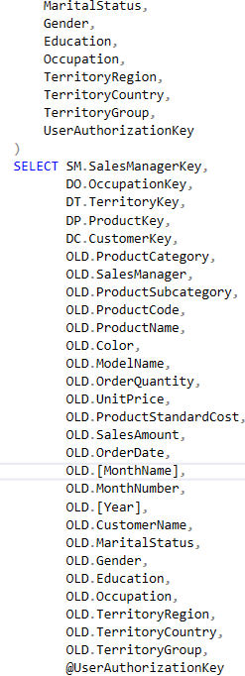
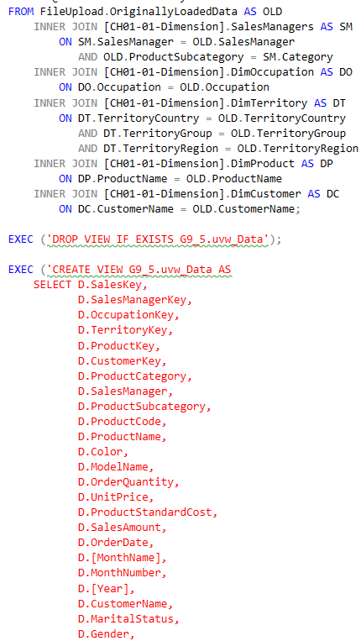
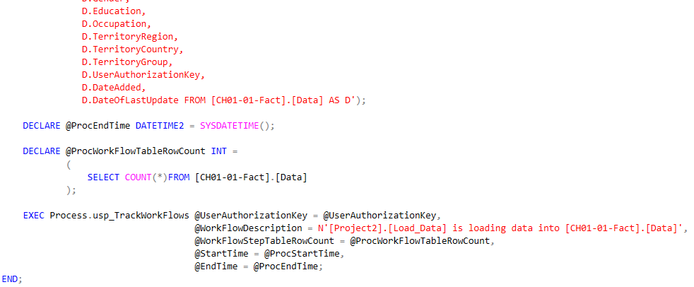
Project2.Load_Data

Slide 32
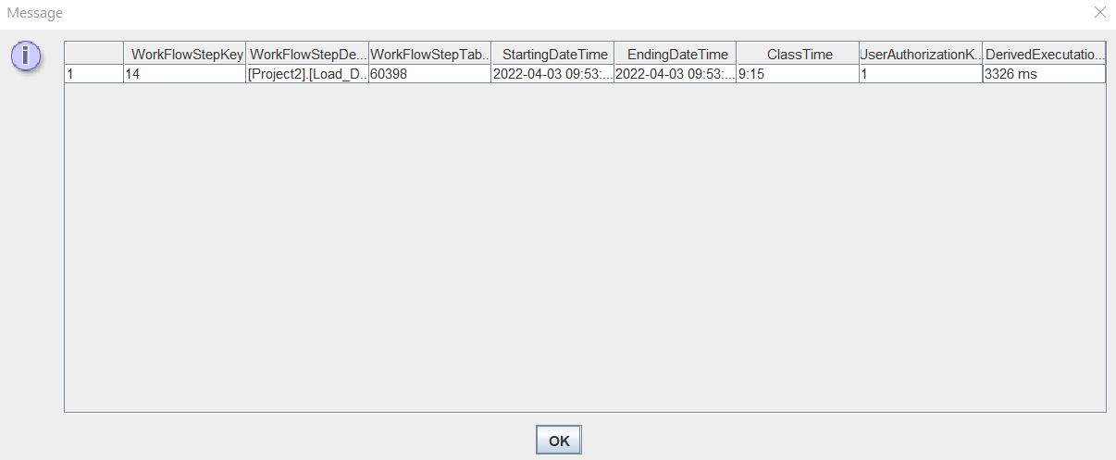
WorkFlowSteps log Entry and Execution time
Execution times: 3326ms (3.326s)

Slide 33
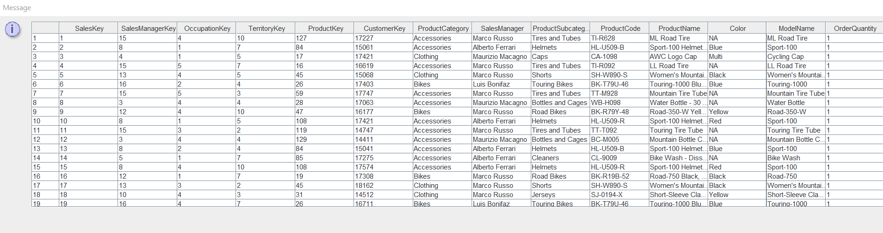
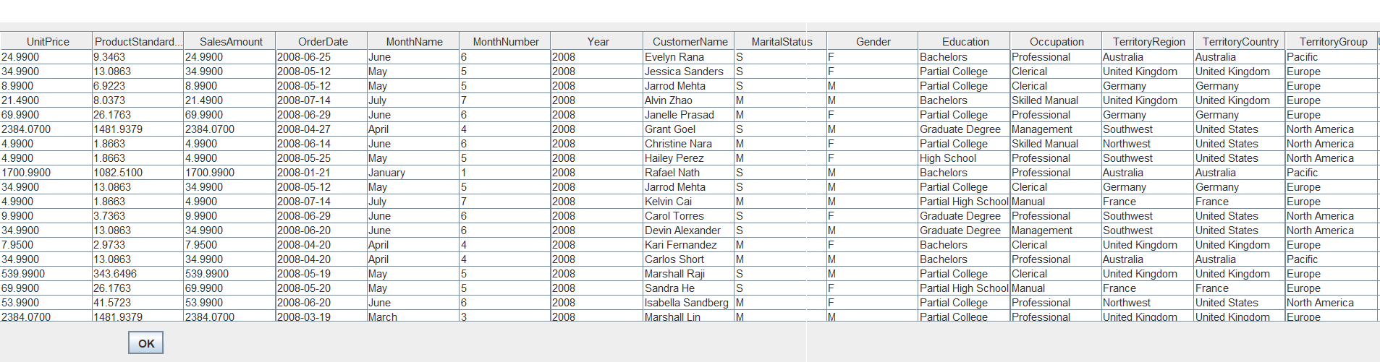
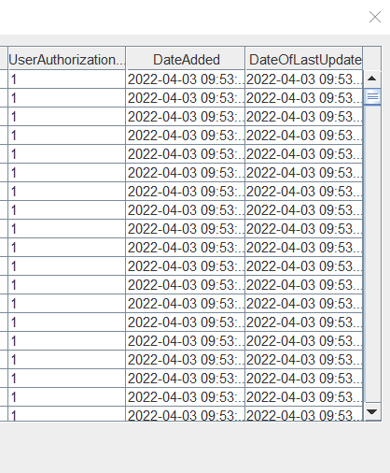
JDBC Output of View

Slide 34
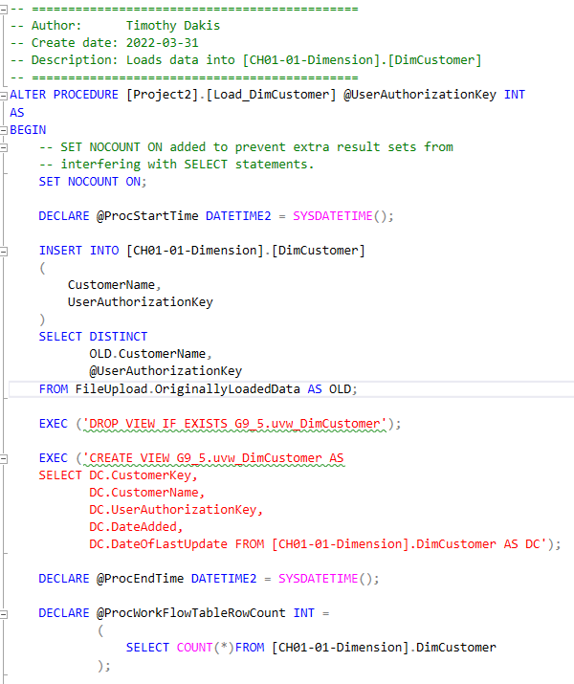
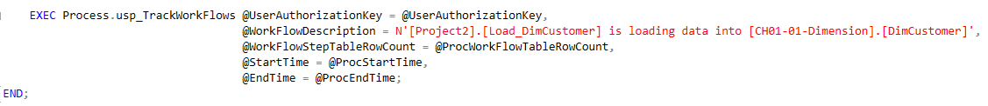
Project2.Load_DimCustomer

Slide 35
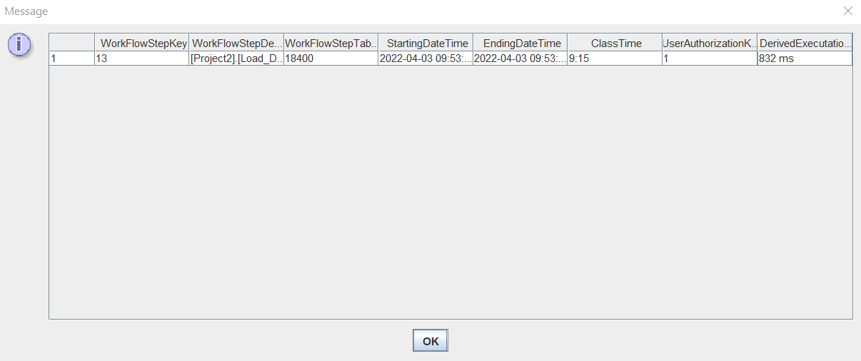
WorkFlowSteps log Entry and Execution time
Execution time: 832ms (0.832s)

Slide 36
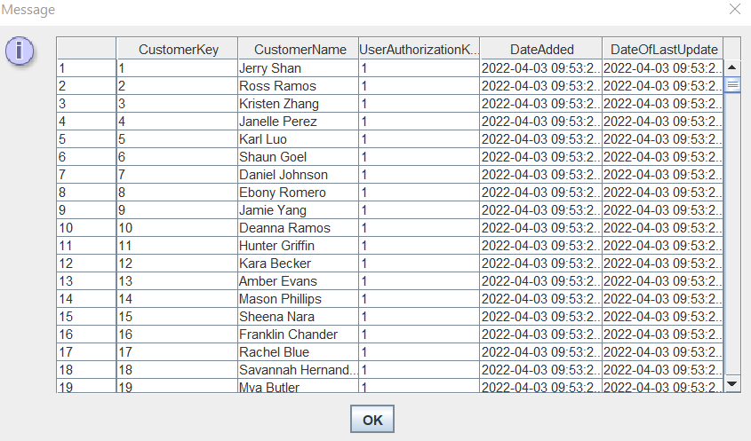
JDBC Output of View

Slide 37
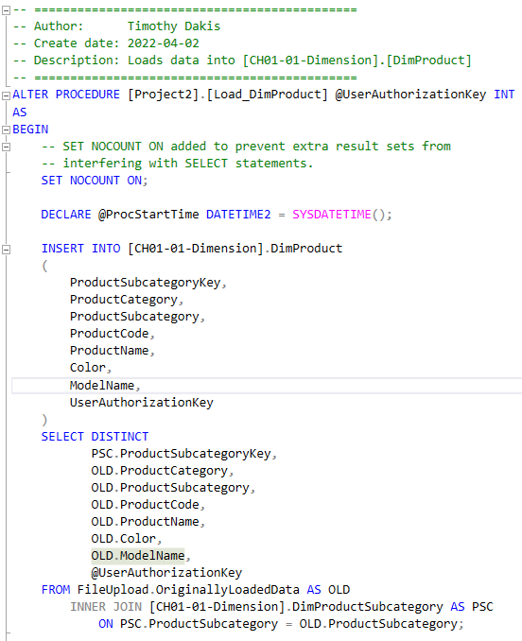
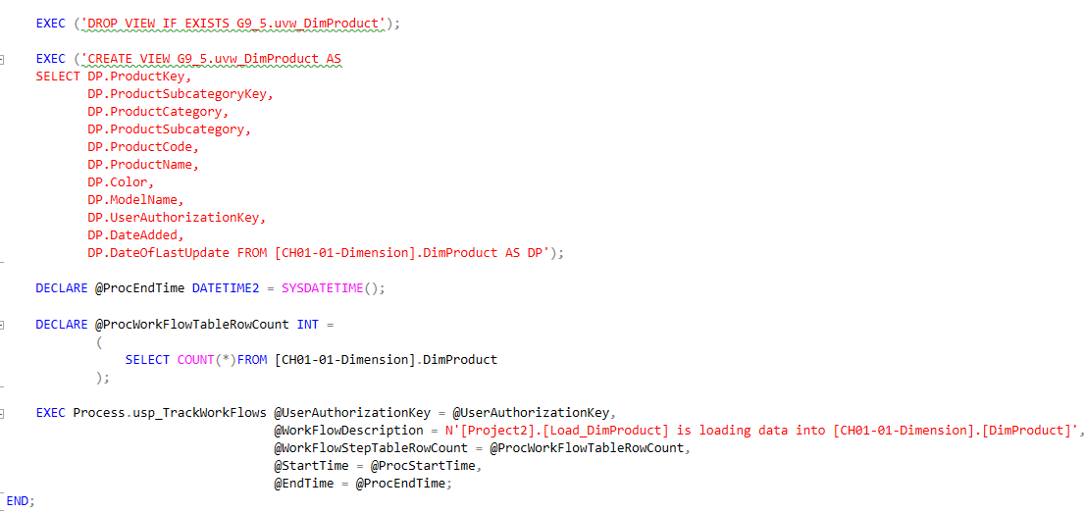
Project2.Load_DimProduct

Slide 38
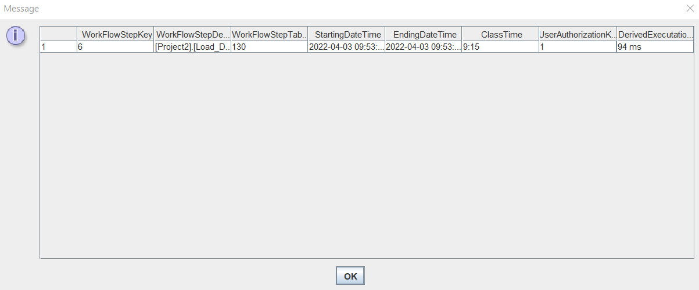
WorkFlowSteps log Entry and Execution time
Execution time: 94ms (0.094s)

Slide 39
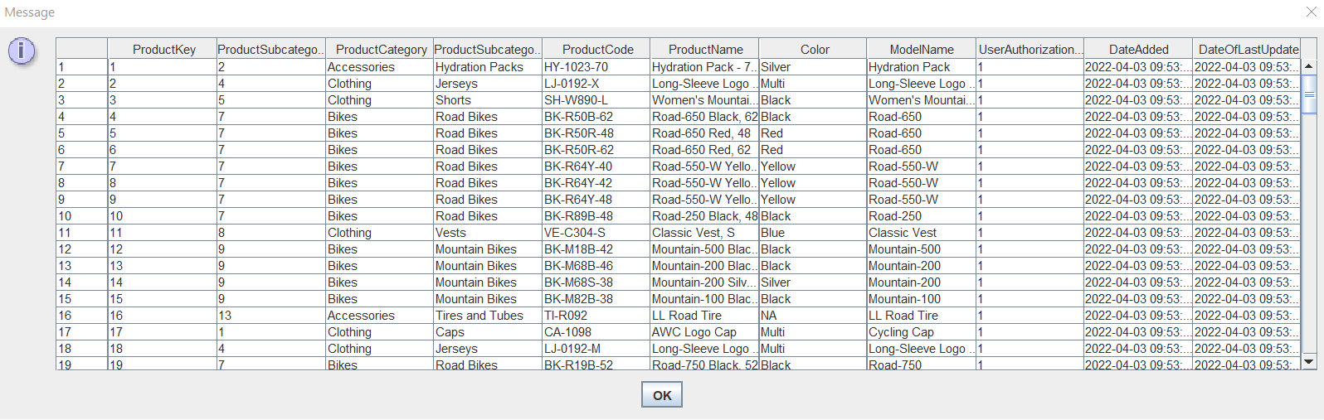
JDBC Output of View

Slide 40
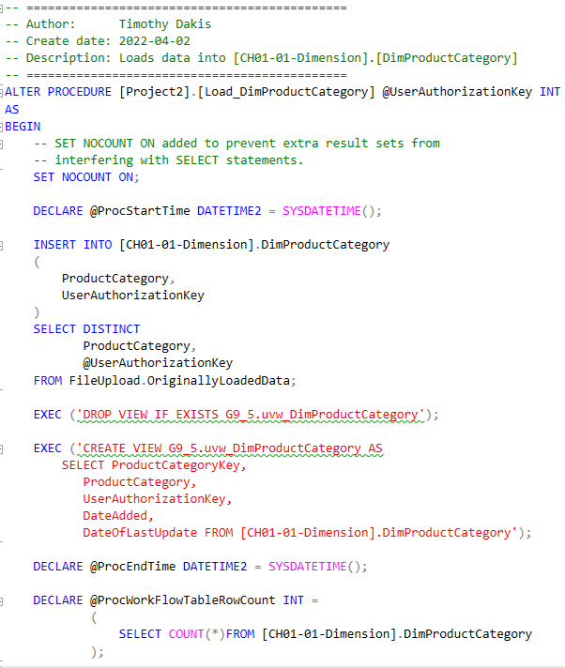
Project2.Load_DimProductCategory

Slide 41
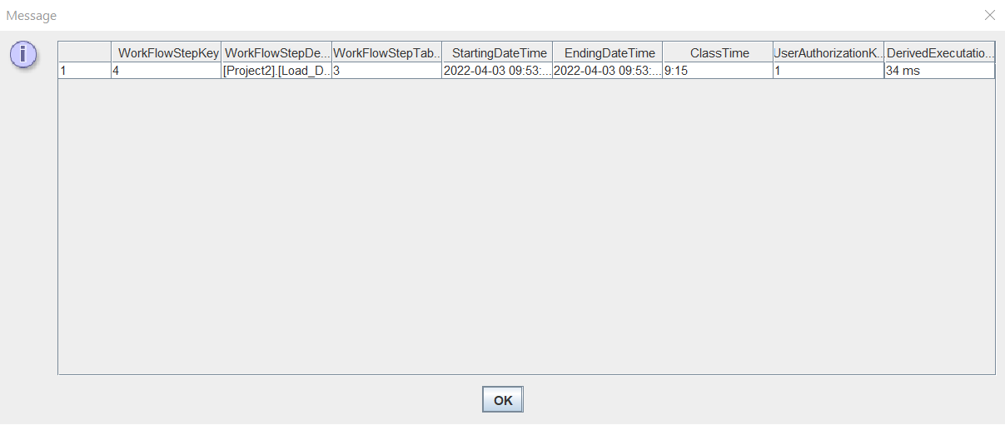
WorkFlowSteps log Entry and Execution time
Execution time: 34ms (0.034s)

Slide 42
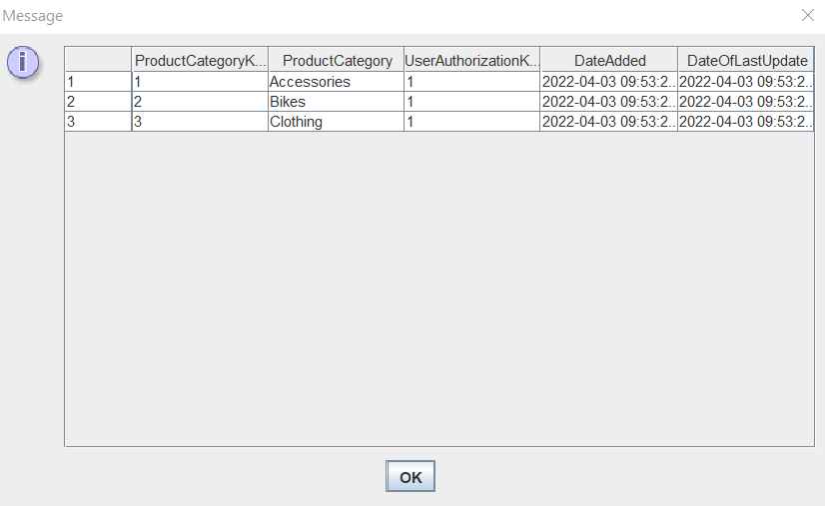
JDBC Output of View

Slide 43
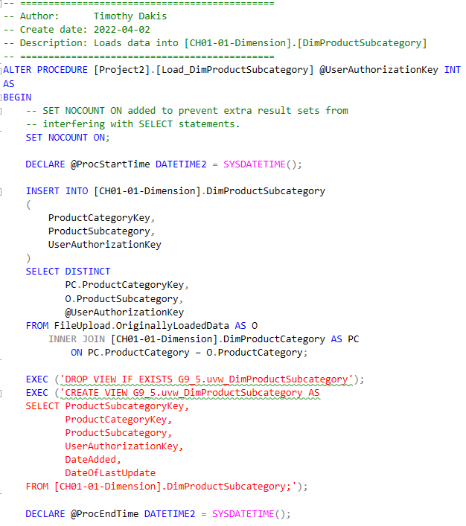
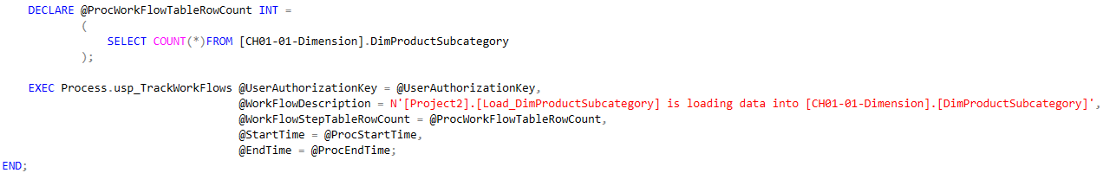
Project2.Load_DimProductSubcategory

Slide 44

WorkFlowSteps log Entry and Execution time
Execution time: 58ms (0.058s)

Slide 45
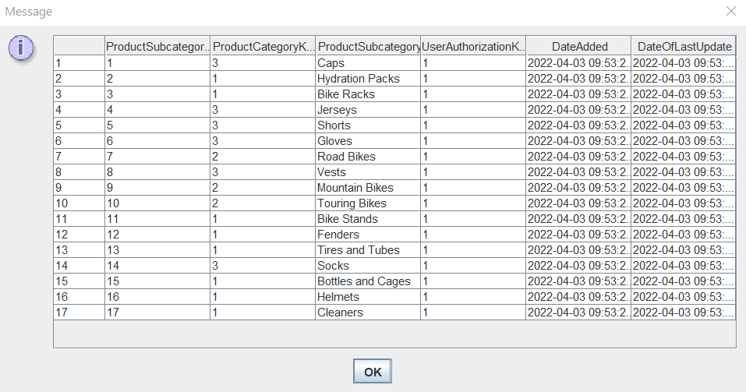
JDBC Output of View

Slide 46
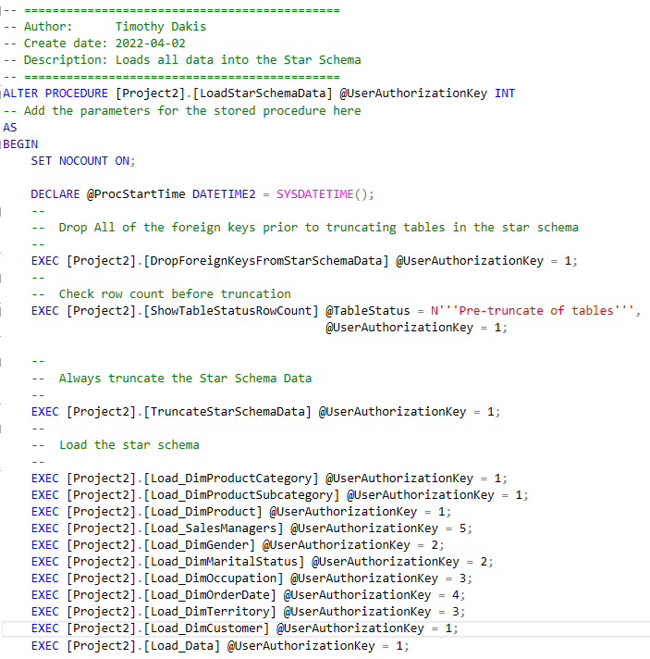
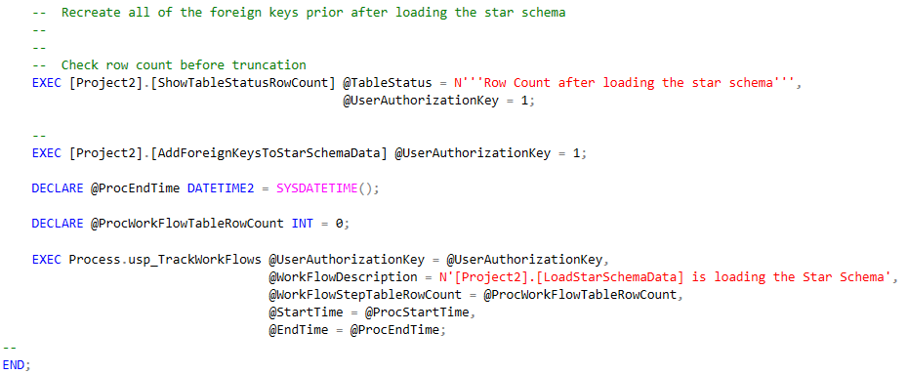
Project2.LoadStarSchemaData
As can be seen, the input for the @UserAuthorizationKey parameter is the value from the DbSecurity.UserAuthorization table shown earlier

Slide 47
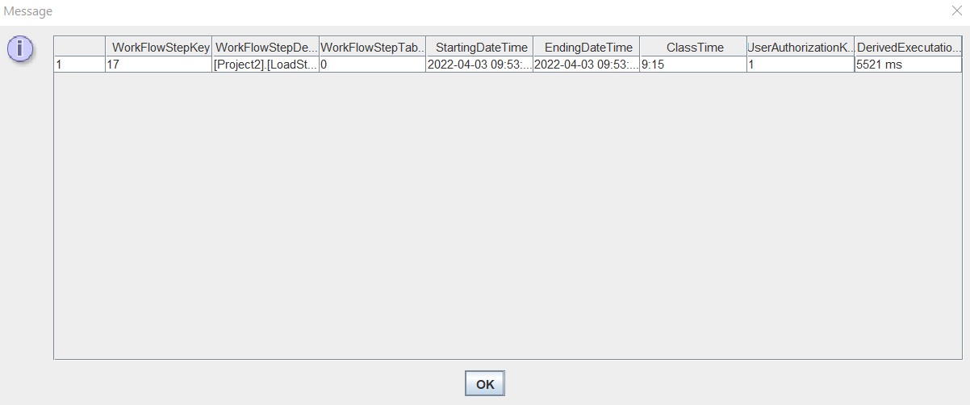
WorkFlowSteps log Entry and Execution time
Execution time: 5521ms (5.521s)

Slide 48
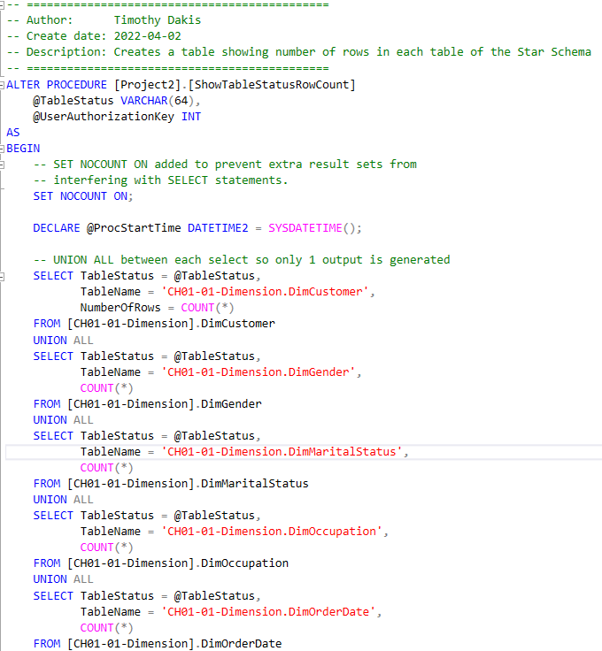
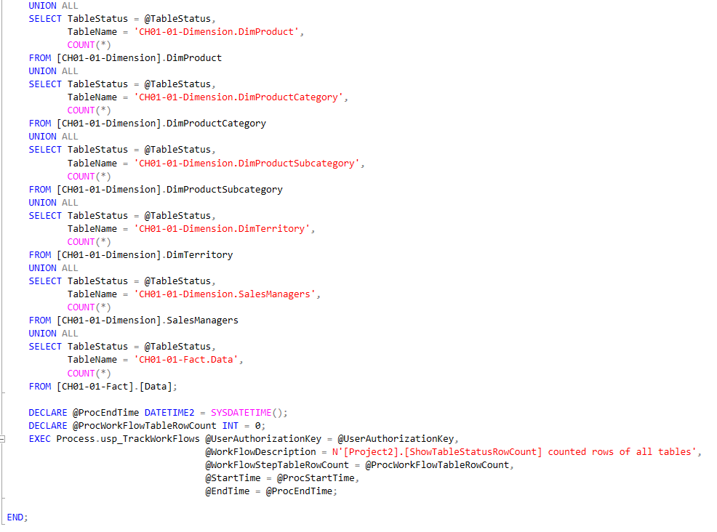
Project2.ShowTableStatusRowCount

Slide 49

WorkFlowSteps log Entry and Execution time
Execution times: 13ms (0.013s) and 8ms (0.008s)
Average execution time: 10.5ms (0.0105s)

Slide 50

Example of JDBC Output of Table

Slide 51


Project2.TruncateStarSchemaData

Slide 52

WorkFlowSteps log Entry and Execution time
Execution time: 74ms (0.074s)

Slide 53

Utils.DropProcsInCSCI331FinalProject

Slide 54
Mikhaiel Gomes’ Procedures

Slide 55
Procedures Done by Mikhaiel Gomes
Project2.Load_DimGender
Project2.Load_DimMaritalStatus

Slide 56


Project2.Load_DimGender

Slide 57

WorkFlowSteps log Entry and Execution time
Execution time: 41ms (0.041s)

Slide 58

JDBC Output of View

Slide 59


Project2.Load_DimMaritalStatus

Slide 60

WorkFlowSteps log Entry and Execution time
Execution time: 50ms (0.05s)

Slide 61

JDBC Output of View

Slide 62
Shivanie Kemraj’s Procedures

Slide 63
Procedures Done by Shivanie Kemraj
Project2.Load_DimOccupation
Project2.Load_DimTerritory

Slide 64


Project2.Load_DimOccupation

Slide 65

WorkFlowSteps log Entry and Execution time
Execution time: 46ms (0.046s)

Slide 66

JDBC Output of View

Slide 67


Project2.Load_DimTerritory

Slide 68

WorkFlowSteps log Entry and Execution time
Execution time: 62ms (0.062s)

Slide 69

JDBC Output of View

Slide 70
Konrad Rakowski’s Procedures

Slide 71
Procedures Done by Konrad Rakowski
Project2.Load_DimOrderDate

Slide 72


Project2.Load_DimOrderDate

Slide 73

WorkFlowSteps log Entry and Execution time
Execution time: 42ms (0.042s)

Slide 74

JDBC Output of View

Slide 75
Kevin Tang’s Procedures

Slide 76
Procedures Done by Kevin Tang
Project2.Load_SalesManager

Slide 77


Project2.Load_SalesManager

Slide 78

WorkFlowSteps log Entry and Execution time
Execution time: 58ms (0.058s)

Slide 79

JDBC Output of View

Slide 80
Analysis
A summary of various components

Slide 81





Time to Load Star Schema and Verifications
Slight time difference makes sense given we no longer factor in the slight delay between everything before the first procedure and everything after the final procedure are run in the LoadStarSchemaData procedure

Slide 82


Further Verification
Again, the total time is 5517ms instead of 5521ms as we are excluding the delay caused by the parts before the LoadStarSchemaData procedure starts executing all other procedures, and also the delay caused by the parts right after it finishes executing all other procedures

Slide 83
Procedures Worked on Per Person
Timothy Dakis:
Process.usp_ShowWorkflowSteps
Process.usp_TrackWorkFlow
Project2.AddForeignKeysToStarSchemaData
Project2.DropForeignKeysFromStarSchemaData
Project2.Load_Data
Project2.Load_DimCustomer
Project2.Load_DimProduct
Project2.Load_DimProductCategory
Project2.Load_DimProductSubcategory
Project2.LoadStarSchemaData
Project2.ShowTableStatusRowCount
Project2.TruncateStarSchemaData
Utils.DropProcsInCSCI331FinalProject
Mikhaiel Gomes:
Project2.Load_DimGender
Project2.Load_DimMaritalStatus
Shivanie Kemraj:
Project2.Load_DimOccupation
Project2.Load_DimTerritory
Konrad Rakowski:
Project2.Load_DimOrderDate
Kevin Tang:
Project2.Load_SalesManager

Slide 84


Time Taken to Execute All of Each Person’s Procedures
Validity check: 5123 + 91 + 108 + 42 + 58 = 5422ms
This matches the output of time taken to execute all procedures (excluding LoadStarSchemaData procedure) shown before:

Slide 85


Time Taken to Execute Each Procedure

Slide 86


WorkFlowSteps Entries for Timothy Dakis

Slide 87

WorkFlowSteps Entries for Mikhaiel Gomes

Slide 88

WorkFlowSteps Entries for Shivanie Kemraj

Slide 89

WorkFlowSteps Entries for Konrad Rakowski

Slide 90

WorkFlowSteps Entries for Kevin Tang

